Slide 1
Video Game Ideation
Concept

Slide 2
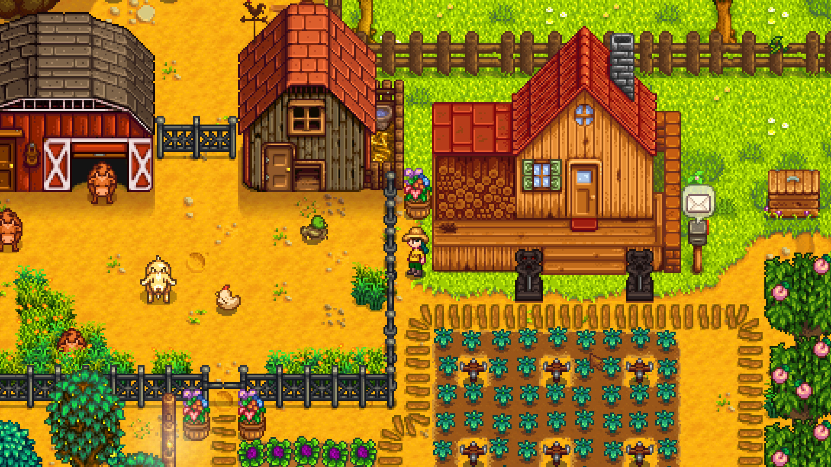
3D or 2D
Decided on 2D for simplicity.
Top Down

Slide 3
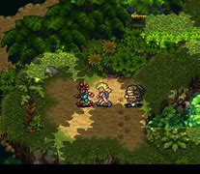
Open World
Characters can move between scenes freely
Each scene has it’s own plot and progression

Slide 4
Single Player
Health And Survival Based
Always vulnerable, survival is the goal
Dungeons

Slide 5
Single Player
Melee Genre

Slide 6
Single Player
Setting:
Modern
Retro
Jungle
City
Old Vegas
Games:
Moonlighter
Dead Cells
Duke Nukem/Doom/Serious Sam
Chrono Trigger
Mario RPG
Chrono Trigger

Slide 7
Single Player
Forests.
Volcanoes.
Nature and the beauty of nature.
Sparsely populated/few NPC’s.

Slide 8
Description of Goals
Player Slots
Usable items
Melee – Sword
Range – Bow
Code Name: Nexus

